Slide 1

COMMUNICATION SKILLS
LECTURE 1 –Introduction to Communication Skills

Slide 2
Fair Use Notice
The material used in this presentation i.e., pictures/graphs/text, etc. is solely intended for educational/teaching purpose, offered free of cost to the students for use under special circumstances of Online Education due to COVID-19 Lockdown situation and may include copyrighted material - the use of which may not have been specifically authorized by Copyright Owners. It’s application constitutes Fair Use of any such copyrighted material as provided in globally accepted law of many countries. The contents of presentations are intended only for the attendees of the class being conducted by the presenter.

Slide 3

First Lesson-Introduction to Communication Skills
We will cover the following:
What is Communication?
Rationale and utility purpose of the course?
What is strategic communication process?

Slide 4
Lecture 1 Essentials:
Aim : To introduce the basic concept of Communication Skills
Objectives: After this class students will be able to:
Define communication skills,
Understand purpose of the course
and will learn basic steps for strategic communication
Assessment (how learning will be recognized): Discussion Prompts incorporated between the lecture, debrief session at the end of the class and mini task assigned for home.

Slide 5
General Introduction (10:am-10:10am)
1. Welcome note by the teacher and a brief introduction about virtual platform-Microsoft teams
2. Virtual Classes- need of the hour (its benefits, doubts and possible challenges )
3. Essential steps to follow during virtual classes to avoid any disturbance
4. Counselling hours and medium to contact the subject teacher.
5. Discussion of different assessment methods for the subject
6. Course content information (availability of TTP, and material sharing by the teacher)

Slide 6
Few Important points to understand
1. Incorporation of “Can we talk about it?” - Questioning, Responding, Clarification, Verification
Any student can ask at any time if they feel they do not understand something by unmuting their mic preferably at the end of the class and saying, “Can We Talk About It?”.
The class will then explain to clarify for student(s) and then proceed following the procedure below.

Slide 7
Procedure:
1. One person asks a question or request clarification.
2. One person, preferably a student, responds and explains the word, concept, or key point.
3. Other students/teacher add comments and examples.
4. Student that asked, “Can we talk about It?” then summarizes in his/her own words the word, concept, or key point.
5. Student receives confirmation or further clarification, if needed, from classmates/teacher.
6. Class continues.

Slide 8
Pluses and Deltas - Formative Assessment – Peer Feedback
Procedure:
1. Audience will listen to any student during online class.
2. Afterwards, audience will give specific feedback to presenters according tot heir presentations.
3. Positive feedback will be given first and then corrective feedback.

Slide 9
Pluses and Deltas Continued
Pluses feedback (e.g., I really liked the photos, they helped me understand better.
Delta feedback (e.g., It would have helped me understand your presentation better if you had more images, maybe next time you can add more charts, graphs and photos.)
3. Students analyzes feedback for improvements.
Note: Corrective feedback must be presented with some type of solution or suggestion for improvement in mind.

Slide 10
Warm Up Prompts
*Are you as students , ready for 21st Century?
* As a student, what do you expect from this course?

Slide 11
Warm Up Prompts (Continued)

Slide 12
Warm Up Prompts(Continued)
What are 21st Century Global Competencies?

Slide 13
21st Century Global Skills:
Based on the answers given by students of three warm up questions, teacher will define global competencies as follows:
21st Century Global Competencies and 21st Century Global Skills all revolve around a similar concept about preparing our students to not just survive, but thrive in life.

Slide 14
21st Century Global Skills(Continued):
The Organization for Economic Co-operation and Development (OECD) is an international organization that works to build policies that result in better lives. They define global competencies in the following way:
“A competency is more than just knowledge and skills. It involves the ability to meet complex demands, by drawing on and mobilizing psychosocial resources (including skills and attitudes) in a particular context. For example, the ability to communicate effectively is a competency that may draw on an individual’s knowledge of language, practical IT skills and attitudes towards those with whom he or she is communicating”.

Slide 15
What do you understand from this definition?

Slide 16
Global Skills
Global competencies are a set of transferrable skills that are essential for students to help them be successful in life (academically, professionally and personally) – whether that’s in a competitive global reality, or in their local communities.
They are also called as 21st century skills or 6 C’s of education.
Graphically they look like:

Slide 17
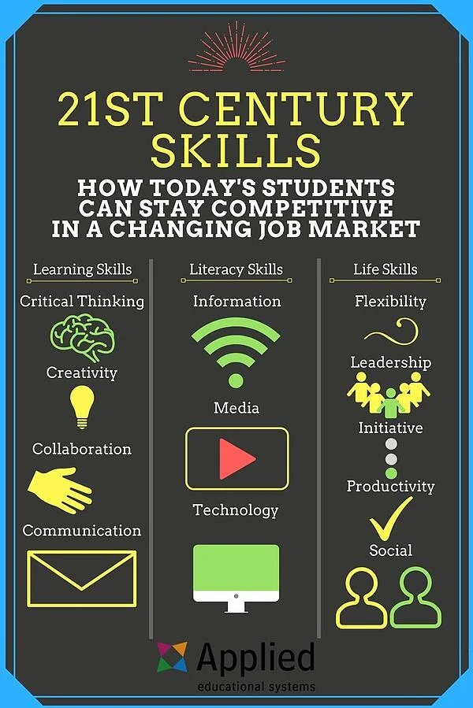
Your understanding about this image?

Slide 18
Communication Skills
By nature for social beings, communication plays a significant part in our daily personal and professional lives.
What comes to mind as you think about the word “communication?” Perhaps you are thinking about the words “talking” or “speaking.” Listening? Understanding? Body language?

Slide 19
What are Communication Skills
Communication skills are important to everyone - they are how we give and receive information and convey our ideas and opinions with those around us. Communication comes in many forms:
verbal (sounds, language, and tone of voice)
• aural (listening and hearing)
• non-verbal (facial expressions, body language, and posture)
• written (journals, emails, blogs, and text messages)
• visual (signs, symbols, colors, and pictures)

Slide 20
Why and how to Communicate?
Being able to effectively communicate one’s needs, feelings and emotions is critical to lifelong success.
Effective communication helps us better understand people or situations and enables us to build trusting and respectful relationships, resolve conflicts, and create environments where ideas, problem solving, and empathy can flourish.

Slide 21
For Example:
Sana met Lareb at a party. Both women engaged in a conversation about their studies and university life. Sana left the conversation with a great impression of Lareb. 'What was it about Lareb that made her such an attractive person?’ Sana wondered. After all, Lareb didn't say anything particularly extraordinary during the exchange.
It was Lareb’s wonderful communication skills that made her such a charming and likable person.

Slide 22

General Communication Skills
Basic communication skills involve building of a rapport.
How do you go about Establishing Rapport?
* You need Self-Confidence
* You must Understand People
* You must be Enthusiastic
* You must make Eye Contact
* You must be Interested in them

Slide 23
You also need to:
Remember names: Pay attention when someone introduces themselves. Use their name at least twice in your conversation with them, but be careful not to overdo it.
Use eye contact: When speaking with someone, look at them in the eyes so that they know you are both trustworthy and engrossed in the conversation, but avert your eyes at times to ensure the eye contact is not overwhelming.

Slide 24
General Communication Skills (Continued)
Ask open-ended questions: People love to talk about themselves and have a tendency to rattle off their opinions, experiences and stories to others. In your next conversation, ask open-ended questions (questions that don't yield a simple 'yes' or 'no' response) to allow the other person to talk about themselves.
Remember to share just enough about yourself to keep the person to whom you are speaking interested.

Slide 25
General Communication Skills (Continued)
Match mood, body language, and voice tone: Try to adapt your mood, body language, and voice tone to match the person with whom you are speaking.
Attentively listen: Avoid looking at your phone or watch, and don't interrupt the speaker. Additionally, refrain from thinking about what you want to say next. Follow-up questions and comments will flow naturally if you truly listen.

Slide 26
General Communication Skills (Continued)
Individuals in the digital age must know how to effectively convey and receive messages in person as well as via phone, email and social media.
Communication is the act of transferring information from one place to another using voice, printed or digital media, body language and gestures.

Slide 27
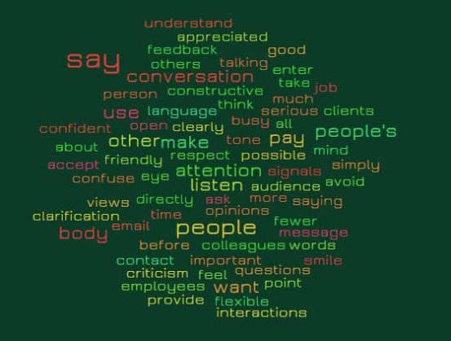
How this image is related to previous slides?

Slide 28
The image shown can be defined as :
Communication is a dynamic process.
Through this process we convey a thought or feeling to someone else.
How it is received depends on a set of events, stimuli, that person is exposed to.
How you say what you say plays an important role in communication.

Slide 29
TOTAL COMMUNICATION PROCESS

Slide 30
LEVELS OF COMMUNICATION
VERBAL
Intra verbal: intonation of word and sound
Extra verbal: implication of words and phrases, semantics
NON-VERBAL
Gestures
Postures
Movements
SYMBOLIC

Slide 31
Why study Communication Skills?
What is its relevance in your field?

Slide 32
Relevance of the Course:
People mostly understand you. But as most of you know, once you get into a work place, and work as a professional/engineer, the game changes.
The stakes get higher. Now, you are expected to solve problems, lead projects, to be an employee who contributes to the bottom line of their organization.

Slide 33
Relevance of the Course (Continued):
You'll find out very quickly that everybody, your management chain, your team, your peers, everybody will scrutinize the way you communicate.
They will judge you, what you say. Is it relevant to the point? Something your audience needs to know, and how you say it. Are you confident, clear, articulate

Slide 34
Relevance of the Course (Continued):
Engineers/Professionals face particularly difficult challenges when speaking in public. You have to explain complex ideas.
Translate technical language into simpler concepts, and persuade others to implement your recommendations.

Slide 35
Strategic Communication?
Think about it
Think about areas in your student life(specifically about studies) where you are required to think strategically. What does that involve?
What does it mean to think strategically?

Slide 36
Strategic Communication (Continued):
You probably know the word strategy, but have you ever heard it in relation to communication?
In today's fast-paced world, many people think of communication as instantaneous. You shoot off an email, you react to a challenging question, you throw together an assignment update for today’s morning class.

Slide 37
Strategic Communication (Continued):
We're used to communicating without thinking, but that style of communication will take you only so far.
If you want to be a leader in any aspect of life, you need to think about what and how you are communicating. You need to communicate strategically.

Slide 38
Strategic Communication in a Nut Shell
What do you want from your audience?
What key thought do you want your audience to remember?
Who is your Audience?
How you will communicate your thoughts to your audience?

Slide 39
Communication Strategy
There are four basic questions you need to answer when you develop a communication strategy. First, who is your audience? Second, what do you want from your audience?
Third, what do you want your audience to know and remember? And last, how will you communicate your thoughts to your audience?

Slide 40
Who is Your Audience?
Your audience is everything. You need to keep them in mind at every step along the way, as you plan, create, and deliver your communication. Never forget your audience.
Get into their heads. Think like they do. If you were in their place, what questions would you have about your topic?
Example: Discuss successful/ popular tv advertisements and reason of their popularity?

Slide 41
What do you want from your Audience?
Your simpler goal can be that your audience understands your message .
For this, speak clearly and easily as per level of the target audience.

Slide 42
What you want your audience to remember
It's important then to decide what one clear point you want your audience to remember. When they walk out of the room, the main point of the message they should remember.
Example: Popular advertisement make audience believe in the goodness of the product and creates a desire to purchase a particular product.

Slide 43
Discussion Prompt:
Describe one example where you have tried to persuade someone to think, believe, or do something.
What arguments did you use? Was your attempt successful?
Share your persuasion example, listen to your class fellows’ and advise them about what they should have done.

Slide 44
How you will communicate your thoughts?
You need to think of the best media to use.
Consider the strengths of each choice. For example, email is great for quick communication. It's easy for people to respond to. But email is not the best medium for delivering a long and detailed or complex and confidential matter.

Slide 45
Conclusion/Debrief by Students
After today’s class, how would you define “Communication Skills”?
Compose your own definition of “Communication Skills” in the chat box and share it with class by unmuting your mic one after another.
Questions from students and instructions for next class.

Slide 46
Debrief activity for home and prompt for next sub topic
1. Based on today’s discussion and lecture, consider as a student you have identified that your laptop has been broken due to certain reason and you have an assignment deadline pending i.e. day after tomorrow. You want to convey this message to your course instructor, however you fear that you will not get an extra time to submit your assignment.
Should you convey this message to your course instructor? Why?
How you will break this news? What medium you will select to convey the news ?
How you will persuade your instructor that you are willing to submit the assignment , just need a little extra time.
What barriers you might face during this communication?

Slide 47
References
tthps://www.dol.gov/odep/topics/youth/softskills/
https://www.aeseducation.com/career-readiness/employability-skills-lesson-plans/
https://www.dol.gov/odep/topics/youth/softskills/SoftSkills-videos.htm
https://educircles.org/21st-century-learning-6cs/
https://www.aeseducation.com/blog/what-are-21st-century-skills
Coursera.com (Oral Communication for Engineering Leaders)

Slide 48
Thank You!

